Slide 1
Data lab of banco de España BELab
Manuel Ortega Ortega
Head of Central Balance Sheet Office Division
6th inexda meeting
Paris
November 22nd, 2019
Statistics department

Slide 2
content
Banco de España launches BELab
Pilot phase of BELab
Some features of the Data base distributed
Output control
Future
Statistics department

Slide 3
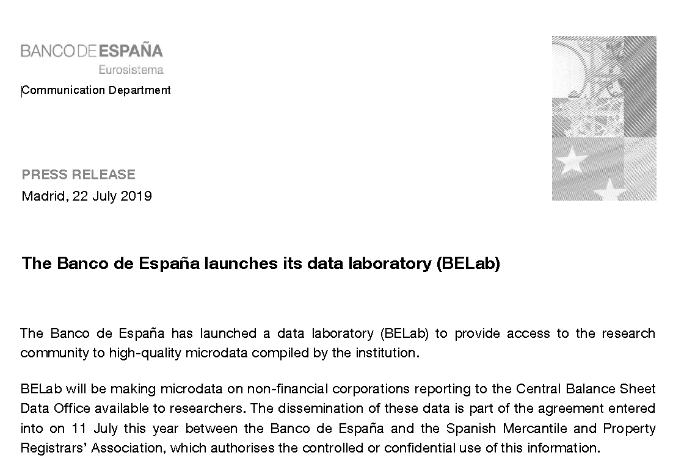
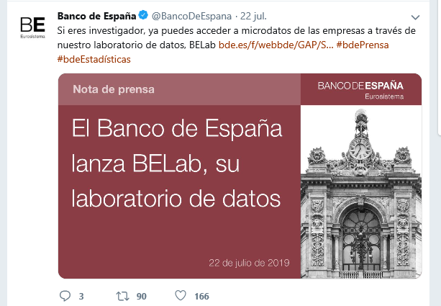
Belab: The data lab of banco de españa
BELab, was launched on July 22nd 2019, by DG Economics, Statistics and Research
Statistics department

Slide 4

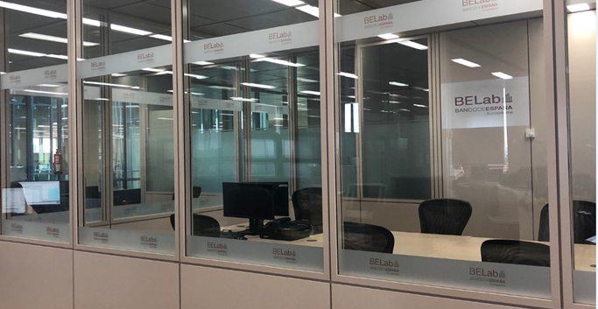
Belab: The data LAB of banco de españa
Pilot phase 0: less sensitive data
Microdata of annual accounts of non financial corporations provided by Central Balance Sheet Data Office (MCB)
To begin with less sensitive data
“On site” access only, using a data room in CBSO premises (Alcalá 522 st)
First researcher: October 9th
Available software: R, Phyton, Stata
On-site access, by “data room”
STATISTICS DEPARTMENT

Slide 5
Belab: The data LAB of banco de españa
Some information oN MCB: Sources
MCB sources (Microdata Central Balance Sheet Office)
The microdata offered in BELab come from the CBI (Integrated Central Balance Sheet Data Office Survey) database:
CBA database: Central Balance Sheet Data Office Annual Survey, from direct and voluntary data contributions by reporting firms (mostly large companies)
CBB database: obligatory filings of annual accounts in mercantile registries (mostly SMEs companies).
CBA
CBB
CBI
STATISTICS DEPARTMENT

Slide 6
Belab: The data LAB of banco de españa
Some information oN MCB: number of companies
Available data bases and blocks of information:
Researchers can choose between two different blocks of information:
Companies that fulfil CB quality standards.
All companies, whether or not they meet CB quality standards.
Annual data are available since 1995. Number of companies has been increasing due to the higher deposit in electronic format and the greater processing capacity.
 | 1995 |  | 2000 |  | 2010 |  | 2015 | 2016 | 2017 | 2018 | TOTAL 1995-2018
All companies | 302.817 |  | 498.400 |  | 976.798 |  | 1.036.940 | 1.026.907 | 939.802 | 682.271 | 18.407.206
Fulfil quality standards | 169.417 |  | 352.750 |  | 777.251 |  | 787.966 | 878.243 | 796.973 | 565.738 | 14.268.260
2.307.101
different companies in the whole series
448.497
common companies in the last 10 years
(panel)
STATISTICS DEPARTMENT

Slide 7
Belab: The data LAB of banco de españa
Some information oN mcb: variables (I)
MCB
Microdata of Central Balance Sheet Office
195 variables harmonized in English and Spanish
Identification variables (non anonymized)
(25 variables)
Profit & Loss and Balance Sheet
(100 variables harmonized to changes in accounting rules)
Derived indicators: Margins, profitability and financial position ratios, payment and collection periods,..
(55 variables harmonized)
Employment variables
(15 variables)
STATISTICS DEPARTMENT

Slide 8
Belab: The data LAB of banco de españa
Some information on mcb: variables (II)
Some identification variables…
NACE
Whole series totally harmonized to the last NACE
Same codification since 1995
Size of companies
According to criteria of European Recommendation '2003/361/EC‘ …even the belonging to a group criterion
Listed companies
Identification of listed and non listed companies
Date of filing and deregistering of insolvency status
STATISTICS DEPARTMENT

Slide 9

Belab: The data LAB of banco de españa
OUTPUT CONTROL
Output control
When the output includes tables or charts BELab will ensure data confidentiality is safeguarded.
For the cross-matching of any sector of activity, size or any other characteristic of the analysis, researchers must offer the variables n (number of agents included in the information node) and ∂ (contribution of these agents to the node), for each variable analysed.
The acceptable outer limits for the dissemination of the information are:
n≥3 and ∂≤85%
STATISTICS DEPARTMENT

Slide 10

Belab: The data LAB of banco de españa
future
Future projects
Addition of new databases
Consolidated Groups databases: listed and non listed
Group relations (group trees)
Balances of Banks
Other BdE micro data
New dissemination options (depending on confidentiality)
Remote access
Subrogated execution
BELab included in the strategic plan of Banco de España (December 2019)
STATISTICS DEPARTMENT

Slide 11
THANK YOU!
QUESTIONS & ANSWERS
STATISTICS DEPARTMENT

